Slide 1
Consumer Flow- PenFed

Slide 2
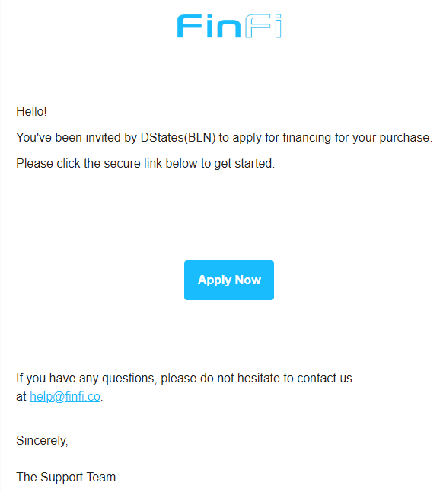
Customer receives an email from help@finfi.com
Consumer clicks on “Apply Now”

Slide 3
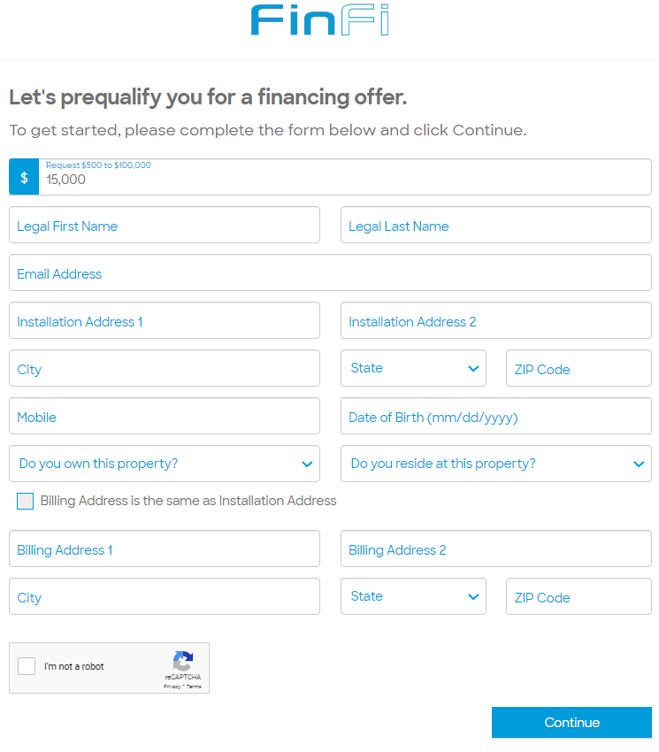
Billing Information
All fields are to be filled:
Requested loan amount (this can be edited at this time)
Legal First Name
Legal Last Name
Email Address
Installation Address
Date of Birth
Do you own this property? (Yes/No)
Do you reside at this property? (Yes/No)
Billing Address
Information provided should match the customer. A mismatch can trigger a fraud alert and may delay funding or cause the application to pend.

Slide 4
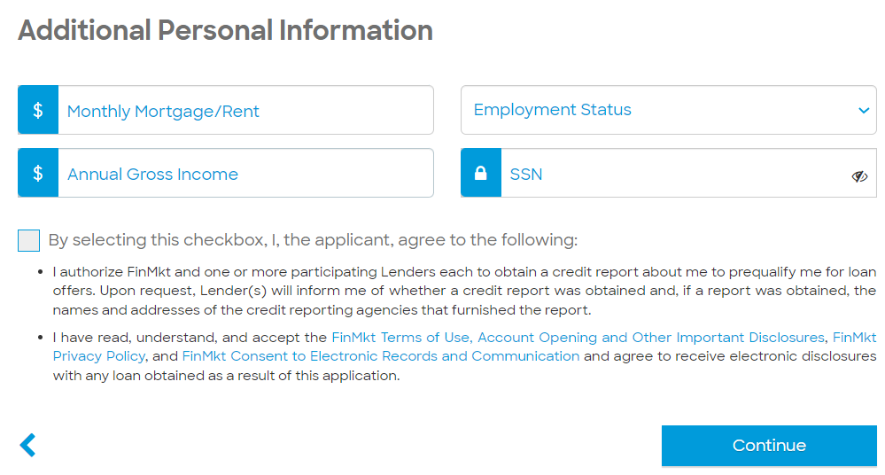
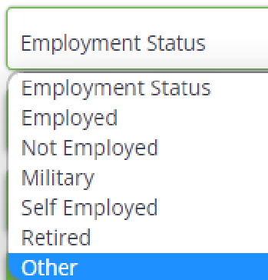
Additional Personal Information
Required Personal Information:
Monthly Mortgage/Rent – The Amount consumer commits as EMIs on monthly basis.
Employment Status - Choose one of the employment options listed.
Social Security Number
Annual Gross Income – Total Amount that a consumer earns in a year
What would happen if the annual gross income is less than 100000?

Slide 5
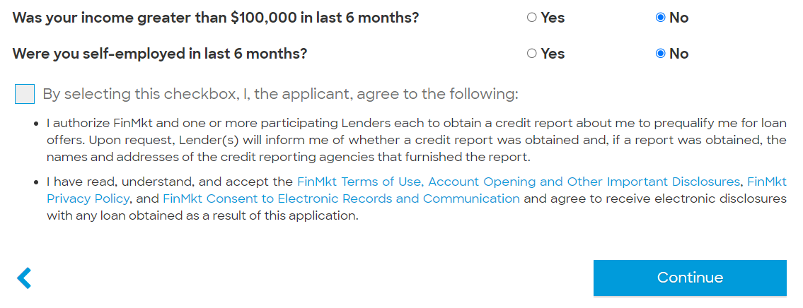
If the annual gross income is less than $100000.

Slide 6
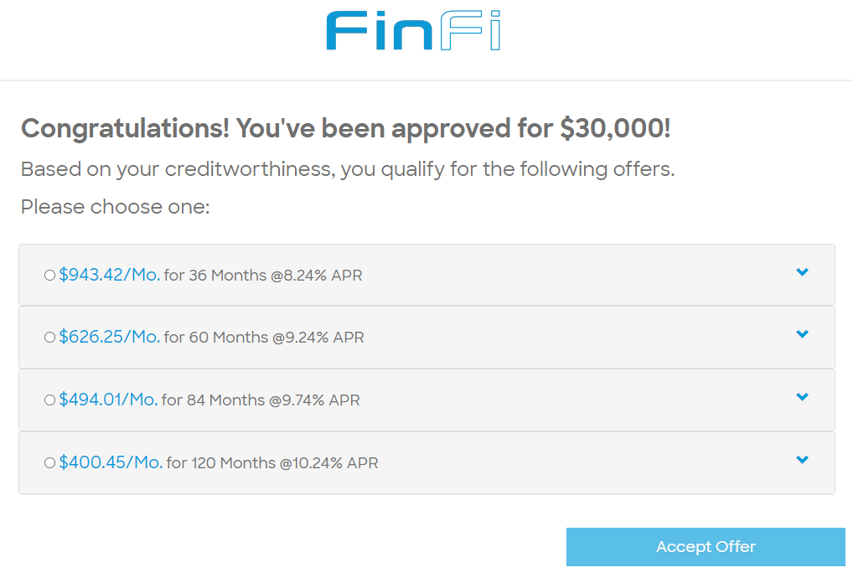
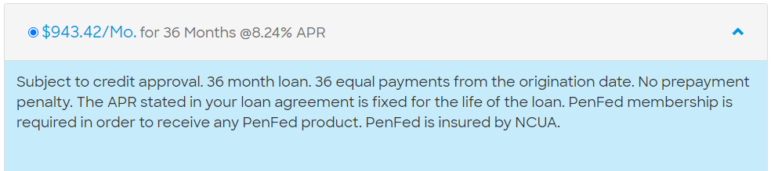
Consumer chooses the offer
Receives different offers:
Offers are presented based on a soft credit pull.
Soft Pull: It is an inquiry into your Credit Report to check the eligibility for the loan. It allows a creditor to review your credit report and credit score to get a sense of how well you are managing your credit. Credit Score does not get impacted.
Customers can click on an offer to view details of the terms
After clicking “Accept Offer,” the customer will be asked to confirm their loan selection.

Slide 7
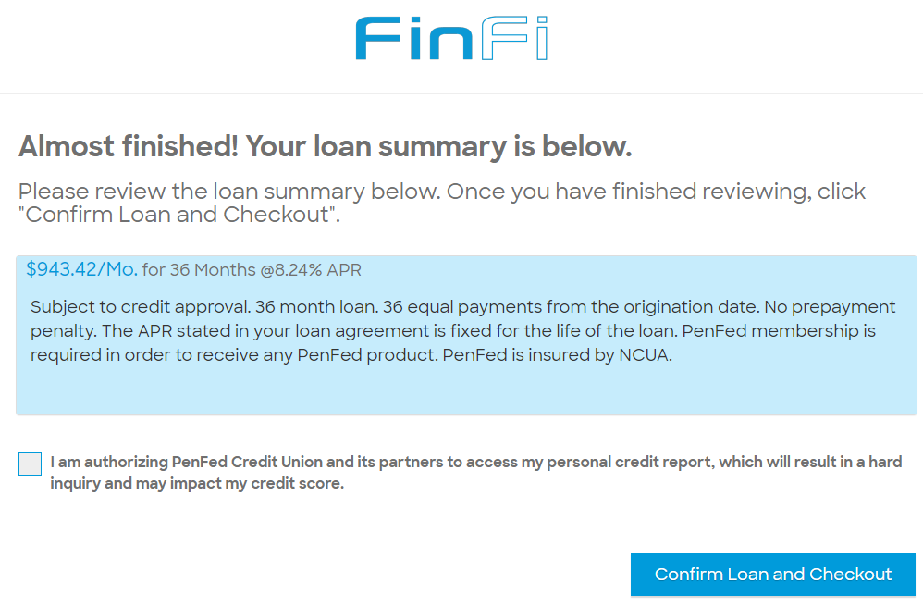
Confirm Loan and Check out
By clicking the ‘Check box’ consumer authorizes PenFed to go for the ‘Hard pull’ as that will impact the credit score of the consumer.

Slide 8
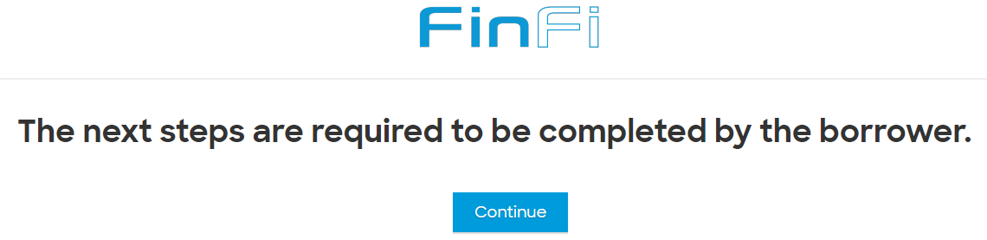
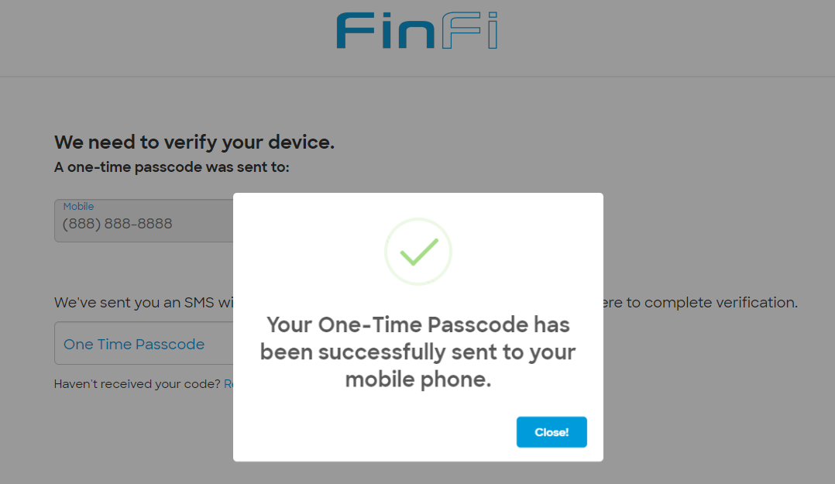
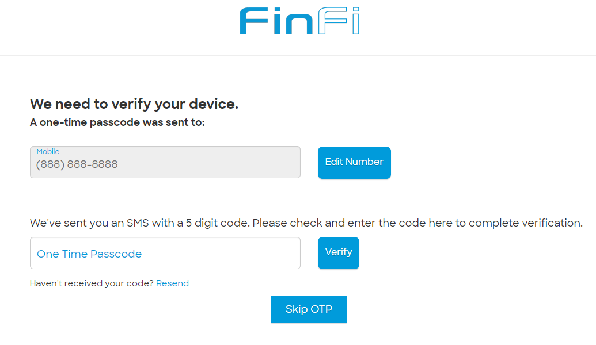
Verify Device
After clicking ‘continue’.
Consumer receives an OTP for verification.
Consumer fills the OTP and clicks on verify.

Slide 9
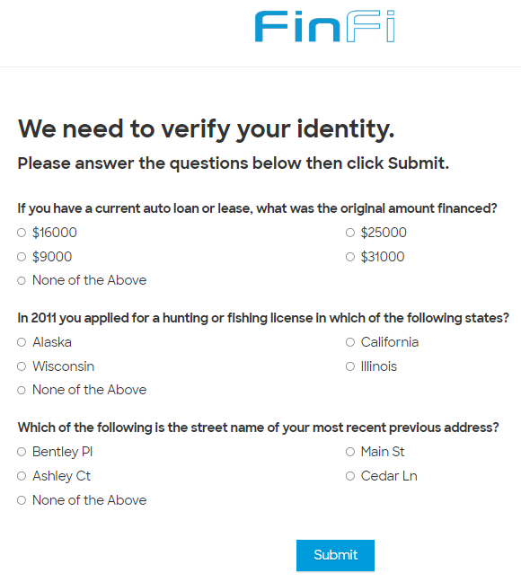
If consumer skips OTP, consumer has to complete this verification.

Slide 10
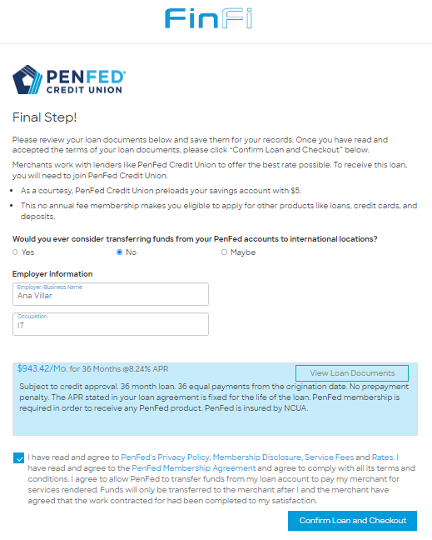
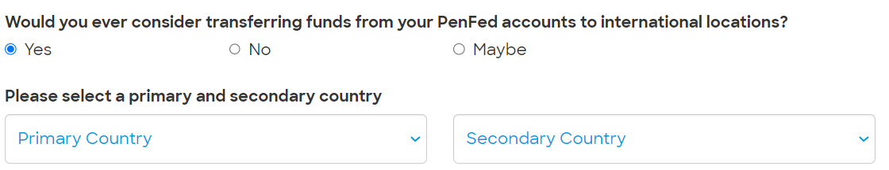
Memberise Steps
If the funds need to be transferred to international account. Need to click on ‘Yes’ or ‘Maybe’
As a Final Step, consumer clicks on the checkbox to allow PenFed to pay funds to the merchant.

Slide 11
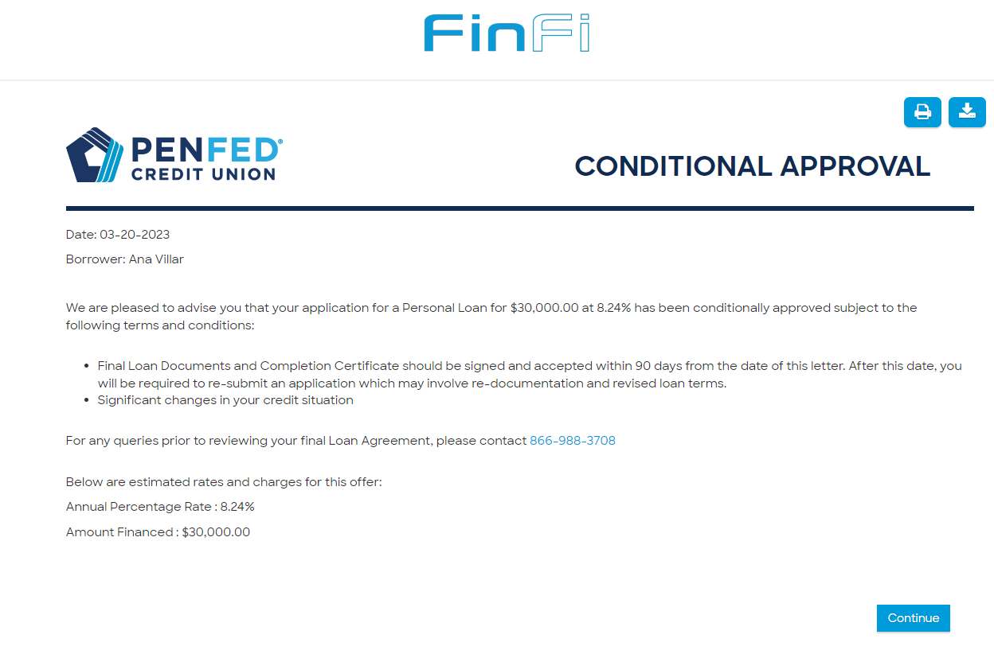
Conditional Approval

Slide 12
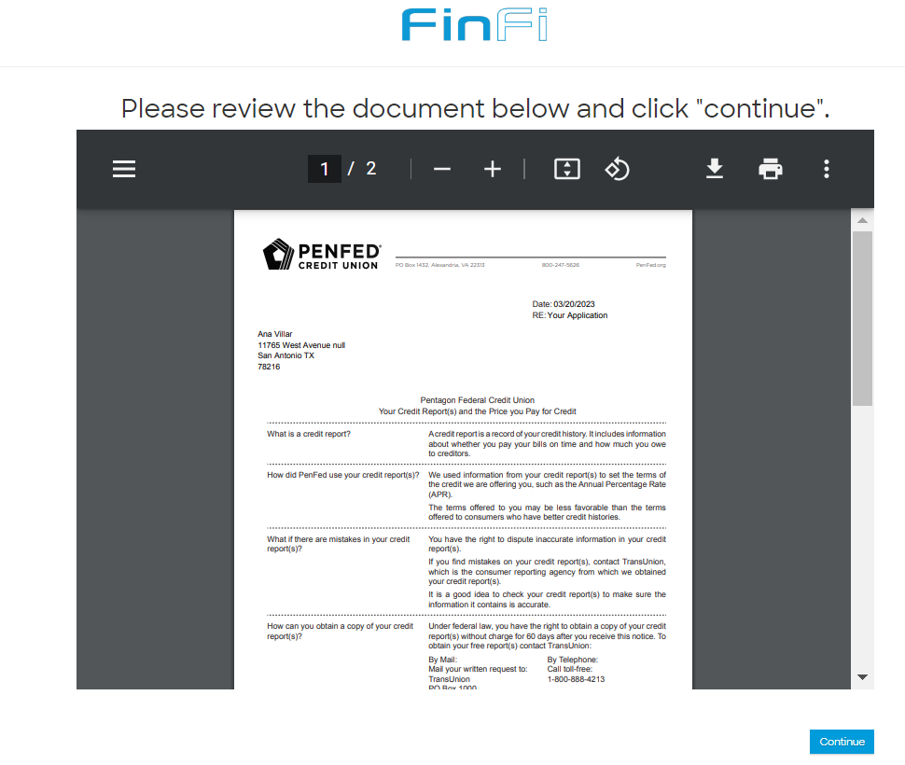
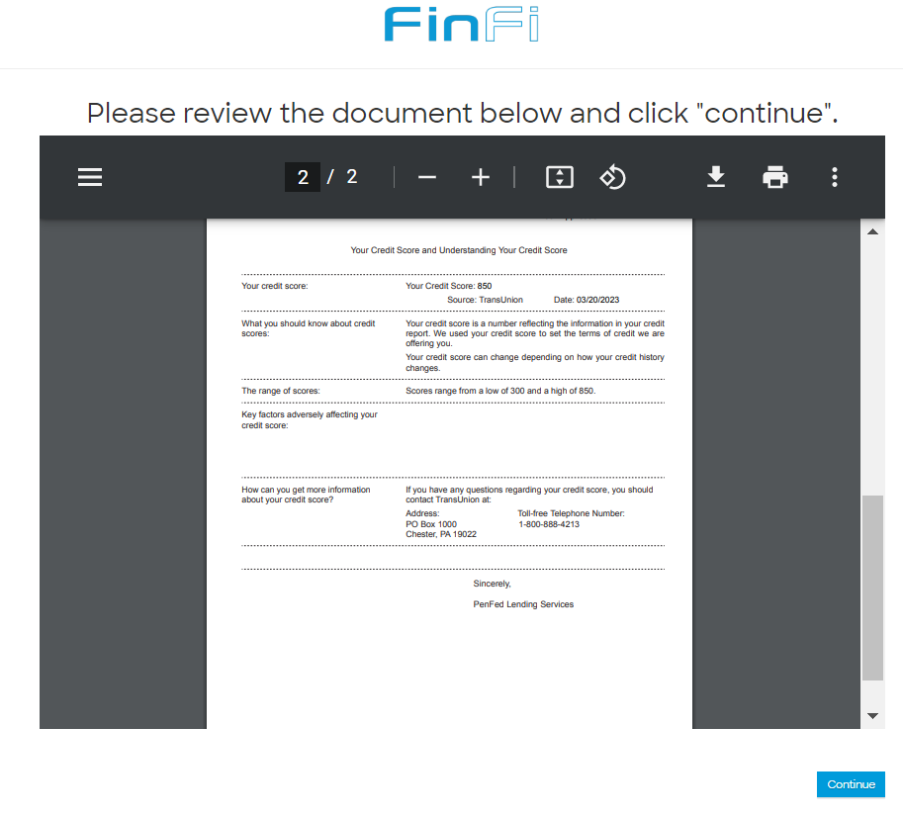
Risk Base Pricing Notice.

Slide 13
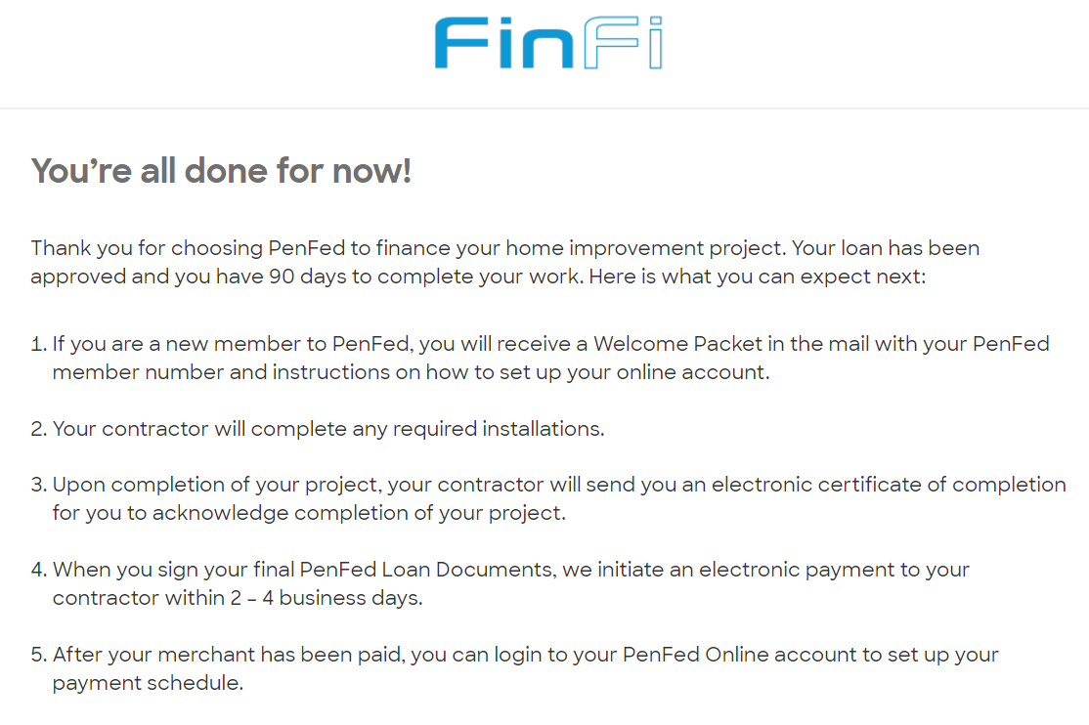
All Set

Slide 14
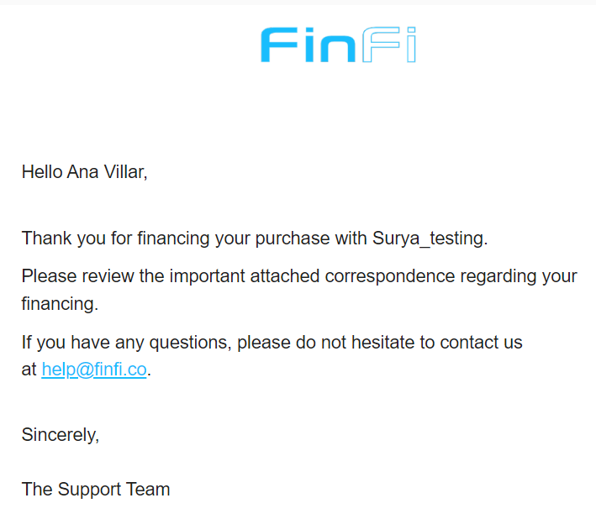
Thank you email sent to the consumer.

Slide 15
Request Payment

Slide 16
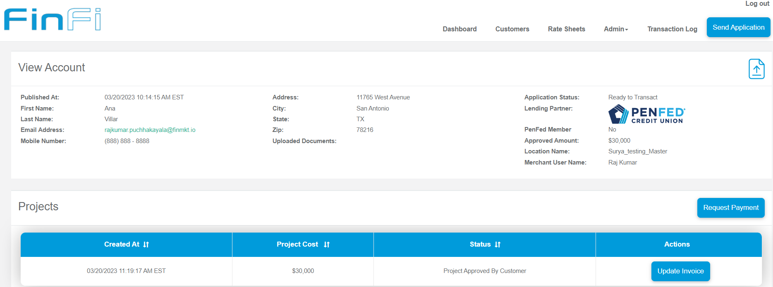
Request Payment

Slide 17
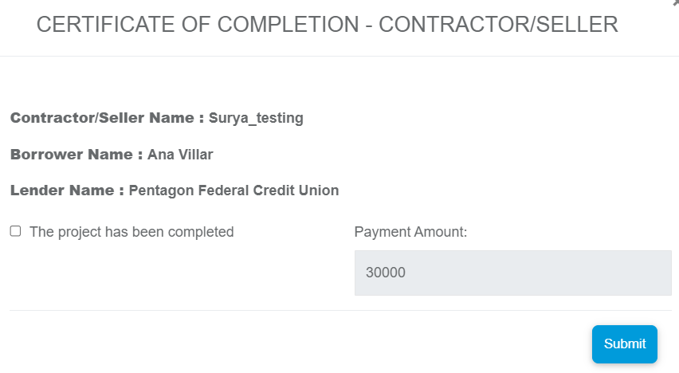
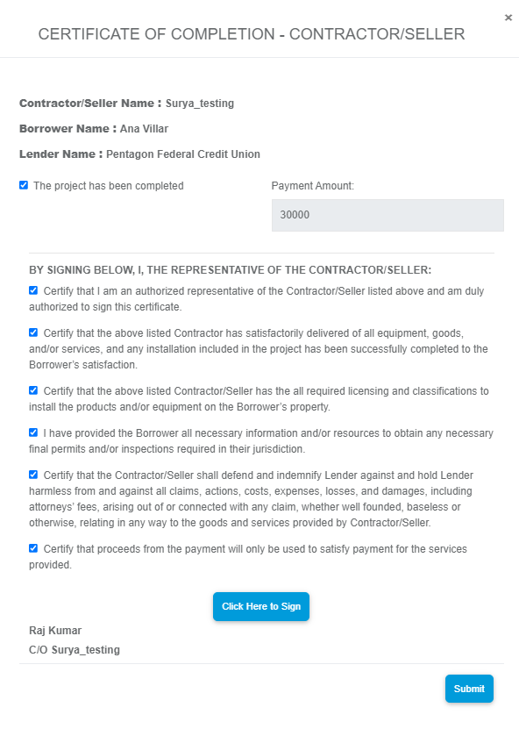
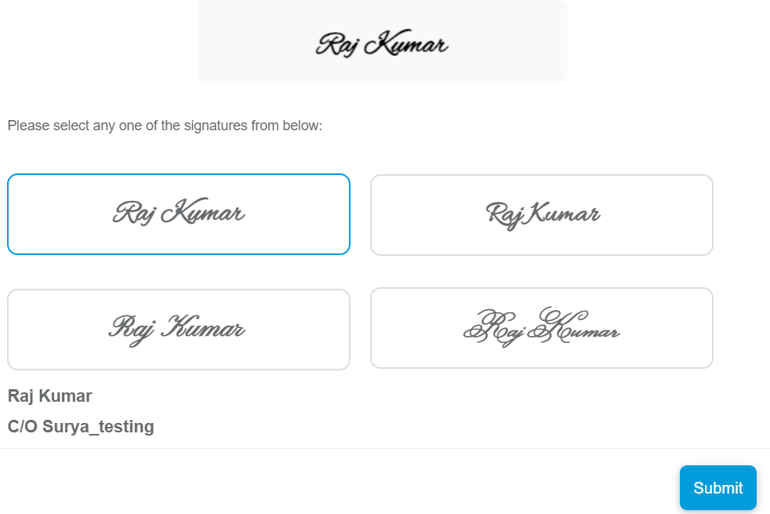
Certification of Completion
Only if the consumer ticks the check box will he see the other points to read carefully and certify. Then consumer signs.

Slide 18
BY SIGNING BELOW, I, THE REPRESENTATIVE OF THE CONTRACTOR/SELLER:
Certify that I am an authorized representative of the Contractor/Seller listed above and am duly authorized to sign this certificate.
Certify that the above listed Contractor has satisfactorily delivered of all equipment, goods, and/or services, and any installation included in the project has been successfully completed to the Borrower’s satisfaction.
Certify that the above listed Contractor/Seller has the all required licensing and classifications to install the products and/or equipment on the Borrower’s property.
I have provided the Borrower all necessary information and/or resources to obtain any necessary final permits and/or inspections required in their jurisdiction.
Certify that the Contractor/Seller shall defend and indemnify Lender against and hold Lender harmless from and against all claims, actions, costs, expenses, losses, and damages, including attorneys’ fees, arising out of or connected with any claim, whether well founded, baseless or otherwise, relating in any way to the goods and services provided by Contractor/Seller.
Certify that proceeds from the payment will only be used to satisfy payment for the services provided.

Slide 19
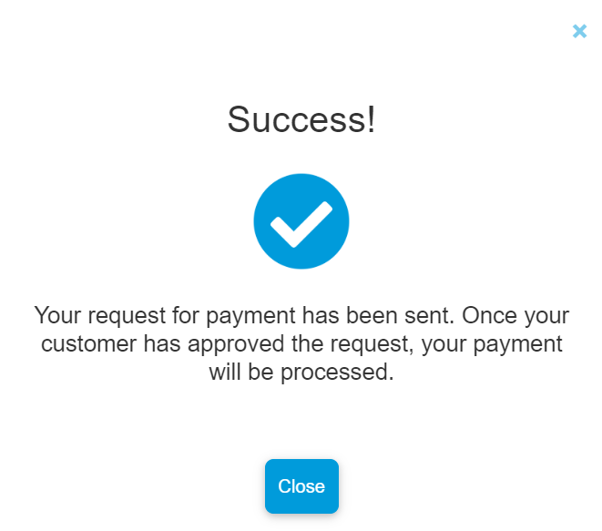
Consumer has to approve the payment

Slide 20
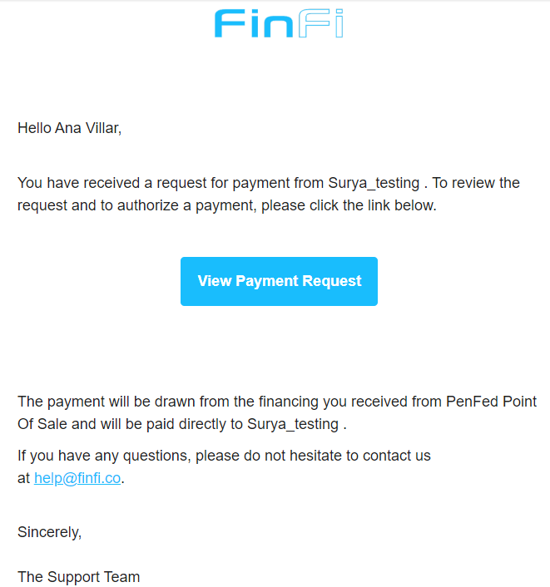
Consumer receives an email for a payment approval.

Slide 21
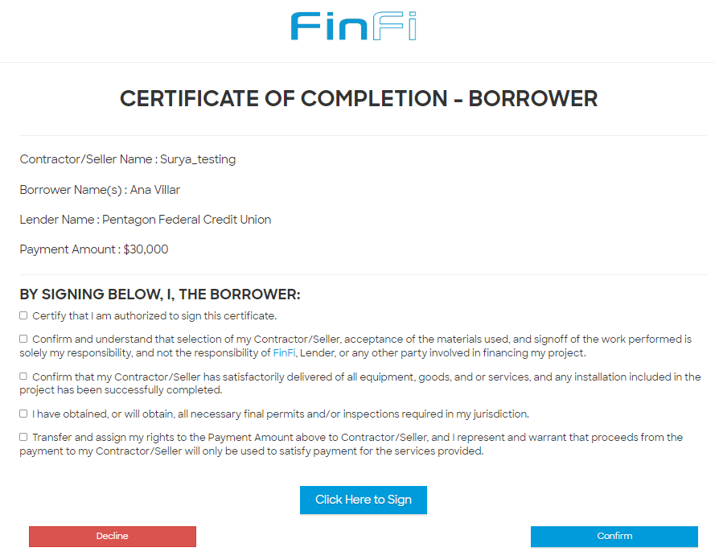
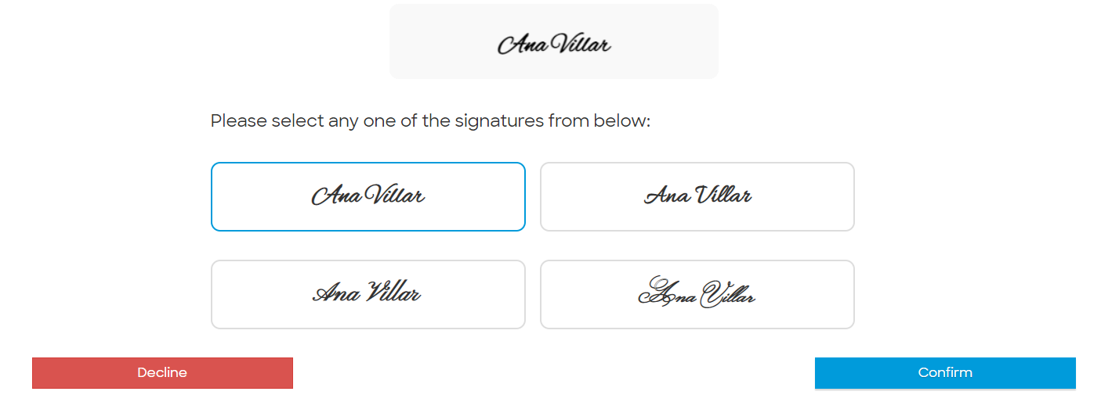
Consumer needs to certify the completion of the project
Consumer has to sign the document confirming the completion of the entire work. Without this step, Merchant will not get paid. If consumer declines here the payment will not be done.

Slide 22
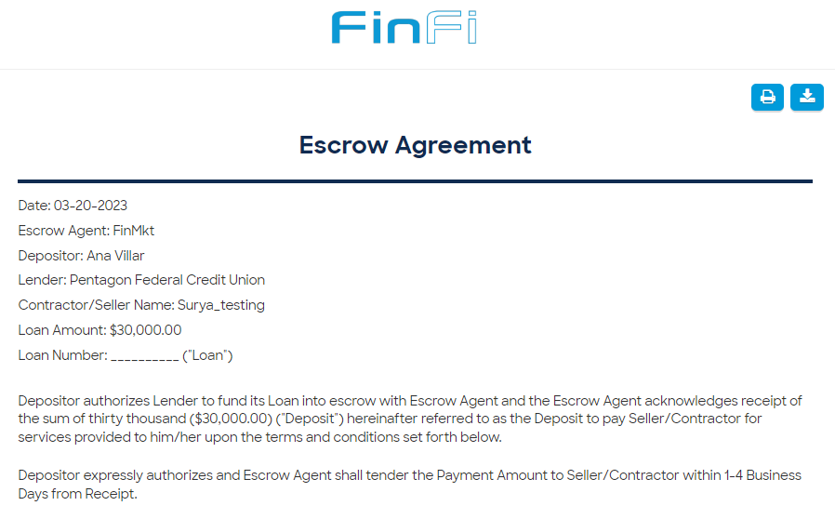
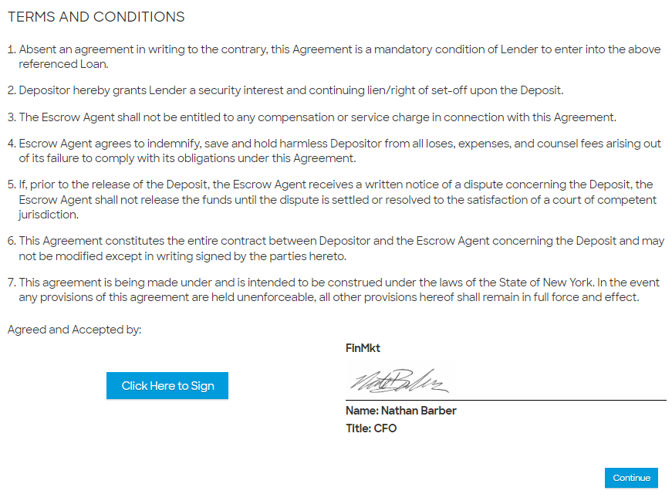
Escrow Agreement
Notes:
The escrow agreement is a financial agreement in which a third party holds the financial payment between two parties. A third party is an independent person who holds the funds to ensure the security of the transaction.

Slide 23
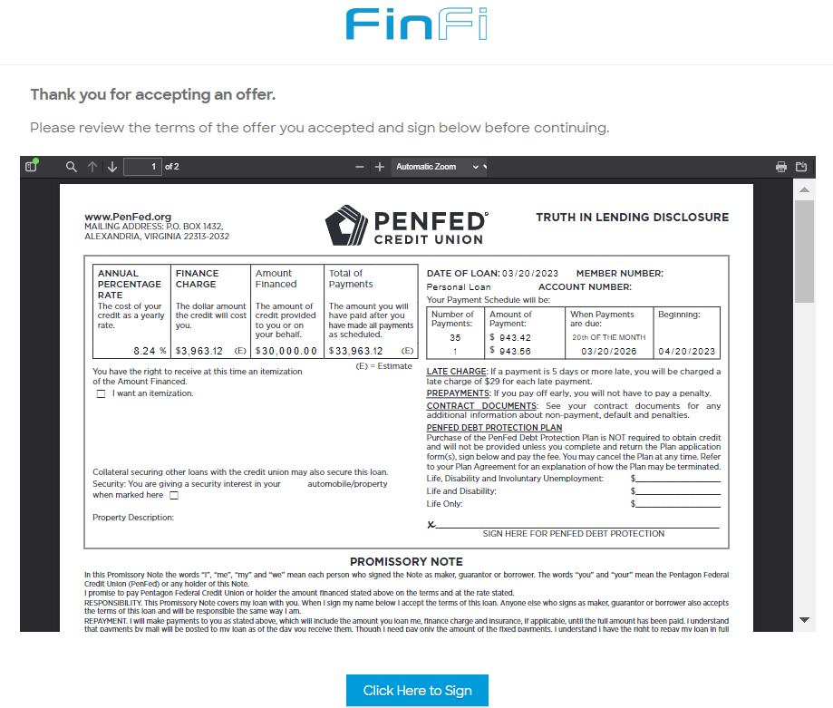
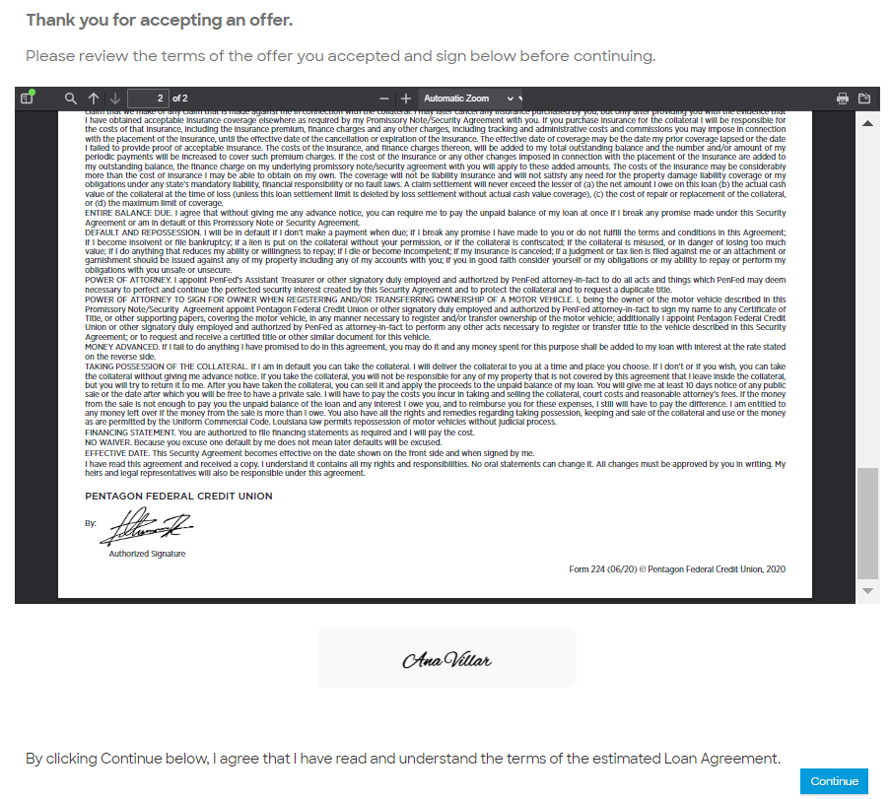
TILA

Slide 24
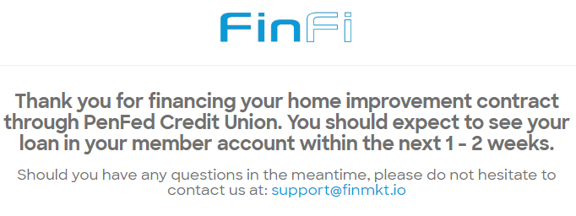
Thank you from FinMkt

Slide 25
Thank You!

